Slide 1
Geographic Hotspots for Activism during the HIV/AIDS crisis
Robert Thombley, Jonathan Renslo, Chris Tonner, Allan Gopez

Slide 2
Project Vision
Develop a foundational understanding of the geography and sociology of activism during the HIV/AIDS crisis in the 1980s and 1990s, as reflected in the No More Silence dataset.

Slide 3
Why is this important?
Provides a sense of the setting for this dataset – grounding a vast collection of artifacts in the tangible, physical world
Provides a foundation for future work to understand the human networks behind the activism
Investigate how the historical centers of activism compare to the geography of people struggling with HIV/AIDS today

Slide 4
Our Approach for Geography
To accomplish our goal of understanding the historical geography of HIV/AIDS activism, we planned to:
Use text mining & NLP approaches to identify zip codes within the text, specifically those that were part of an address
Easier to eliminate false positives, when conditioned as part of structured text
More likely to be important places associated with activism
Find counts of each zip code and the number of unique projects/documents associated with each zip code
Map those at San Francisco, California & US level

Slide 5
Our Approach for Sociology
To accomplish our goal of understanding the historical sociology of HIV/AIDS activism, we planned to:
Use text mining & NLP approaches to identify people’s names within the text
Group name that appear in the same document or project
Create graphs to visualize the human networks of people, where edges in the graph represent people who were part of the same document/project.

Slide 6
Extracting Addresses
A ”regular” approach...
Pattern based matching (regex)
5 digit numbers, with or without additional 4
Identify and eliminate phone numbers as candidates
Validation by associated address
Libpostal, python re
Looked into geocoding, but cost was a barrier
Notes:
Anchoring on zip codes
Pattern based matching (regex)
Anticipate questions
Why simple method? Why not lstm or convnet? -> options were to label corpus, or apply existing models. We used spacy (which is a variation on a conv net, as yet unpublished), in order not to have to label.

Slide 7
Extracting Names
Approach:
Names are nouns
Names are (usually) not standard English words
Lists of known names are publicly available
Search for out-of-vocabulary words in noun phrases
Use existing NER tagging (Spacy)
Validate with dictionary of known names -> hard to do
Difficulties:
OCR: Missing spaces confuse NER models
Lists of names (participants) in text that are hard to segment
Notes:
Noun phrases not in vocabulary
Spacy’s NER Tagger

Slide 8
Names are hard
Chose to focus on zip codes first because of the difficulty of validating names
Hard to distinguish between a name and other parts of the text
Many names were redacted
No easy way to validate names

Slide 9
Analysis & Mapping
To approach mapping, we started with a data frame where each record represented a specific zip code mention, from a specific document
We then counted, for each zip code found, the number of unique documents (aka projects) they appeared in and the number of total mentions across all projects.

Slide 10
Analysis & Mapping
We then created two types of maps:
Dot plots: Above the centroid of each zip code, we plot a colored circle with its area scaled to the number of mentions and color scaled to the number of unique projects.
Heat maps: A map of all the zip codes in the bay area, color coded to the number of zip code mentions

Slide 11
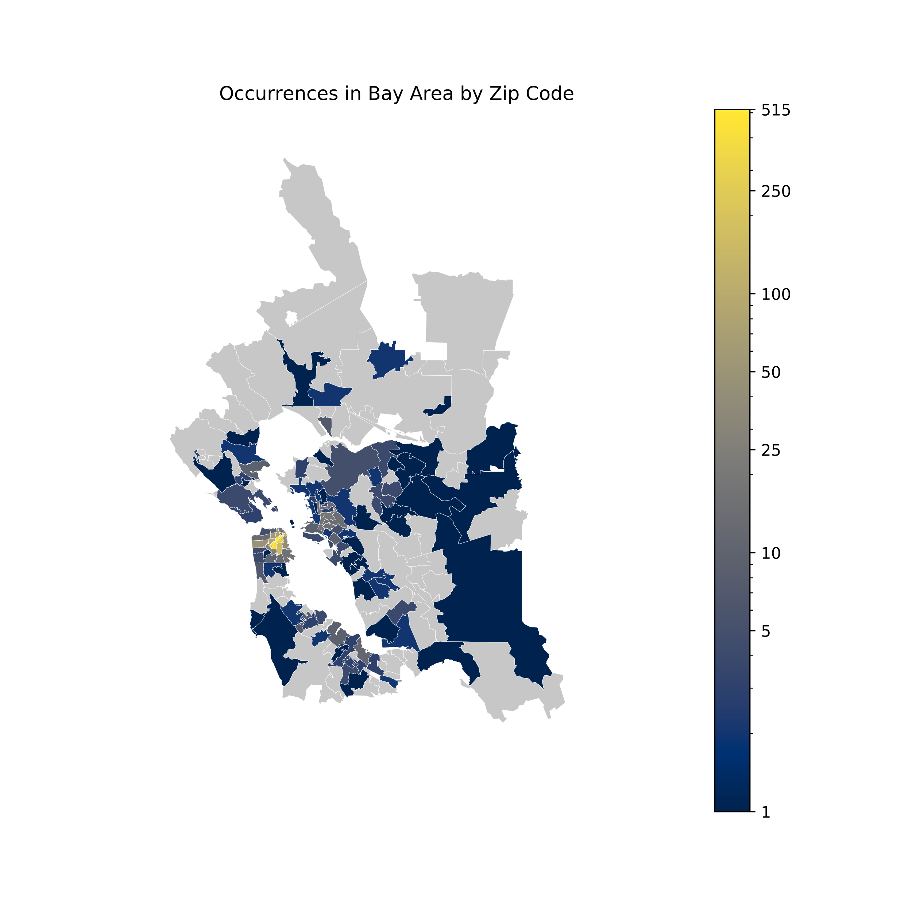
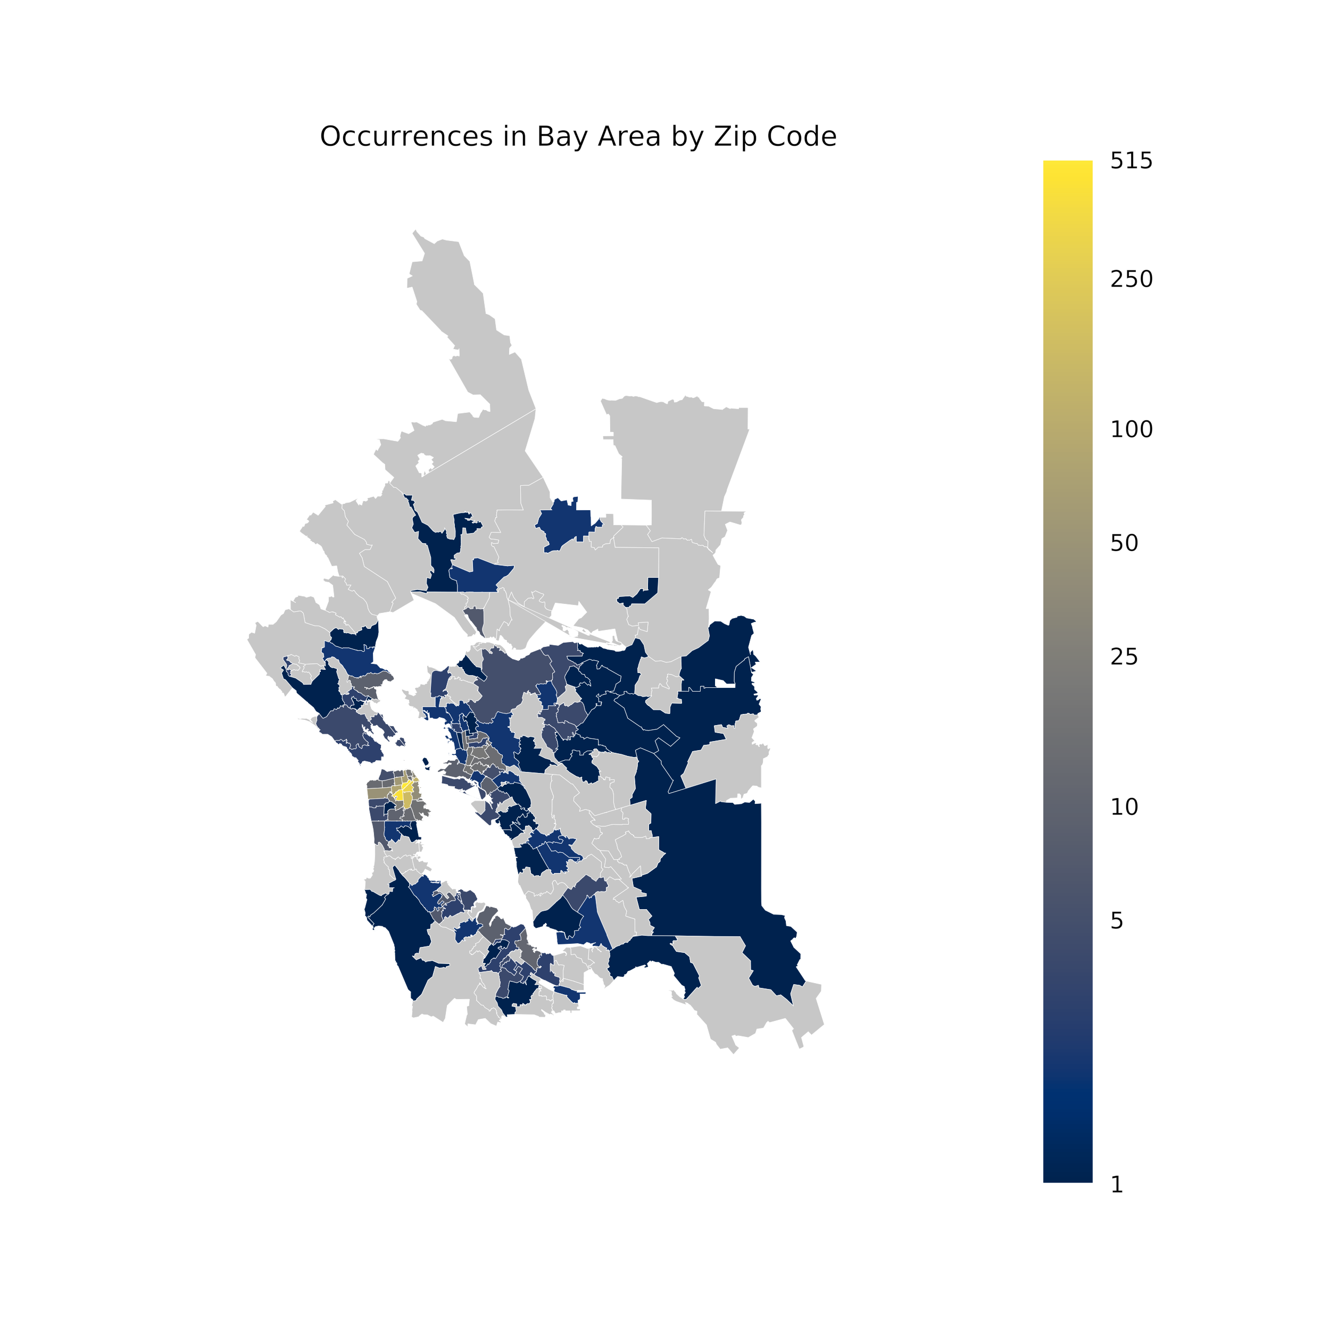
San Francisco

Slide 12
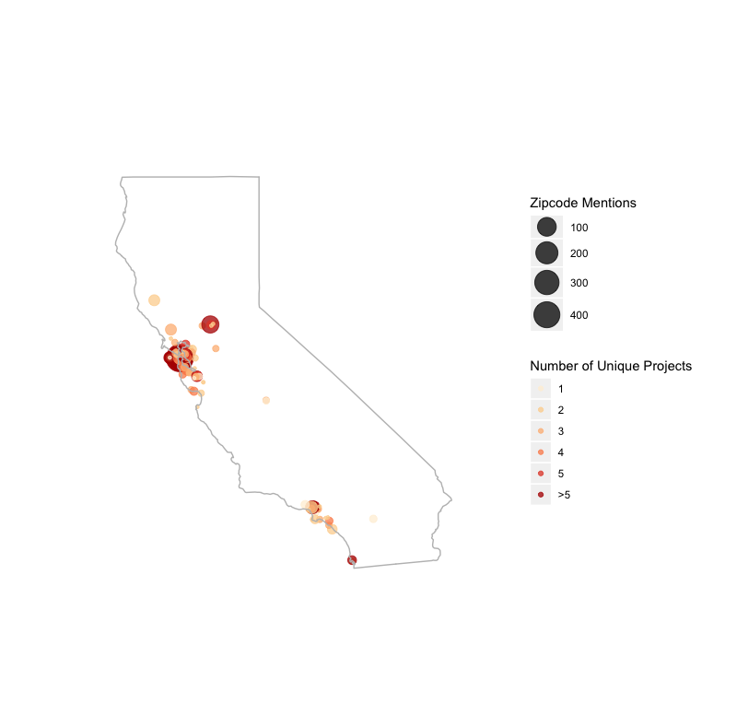
California

Slide 13
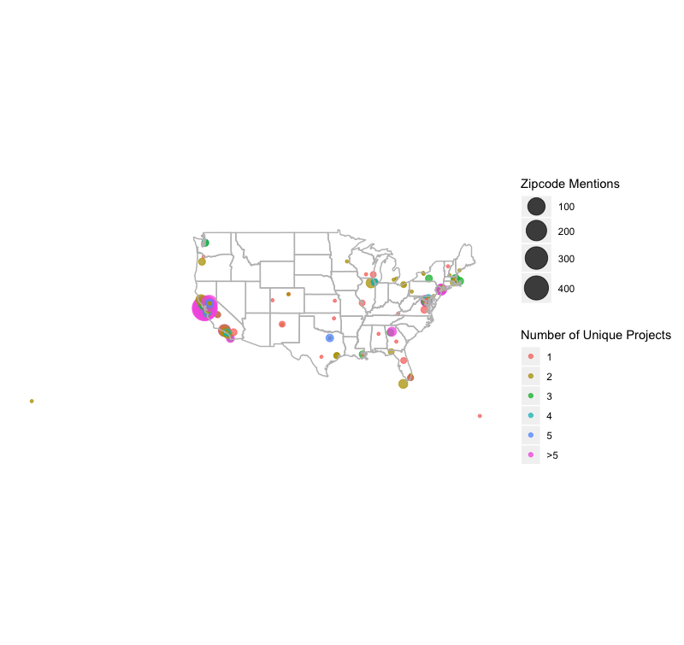
USA

Slide 14
Discussion
What do we see?
Clusters in cities
Important locations: San Francisco, Sacramento, LA, Atlanta, Washington DC, Dallas, New York City
Could potentially view these clusters as “centers of historic activism”
How does these clusters relate to current & historic geographies of the incidence of people with HIV/AIDS?

Slide 15
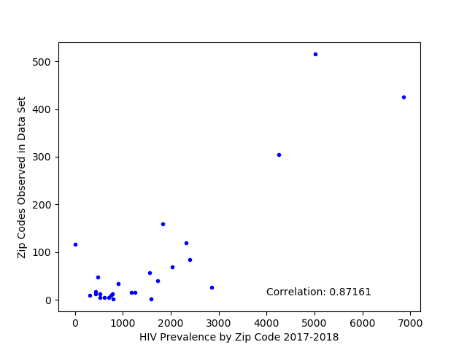
Activism and Disease Prevalence
Notes:
Do we include this plot?

Slide 16
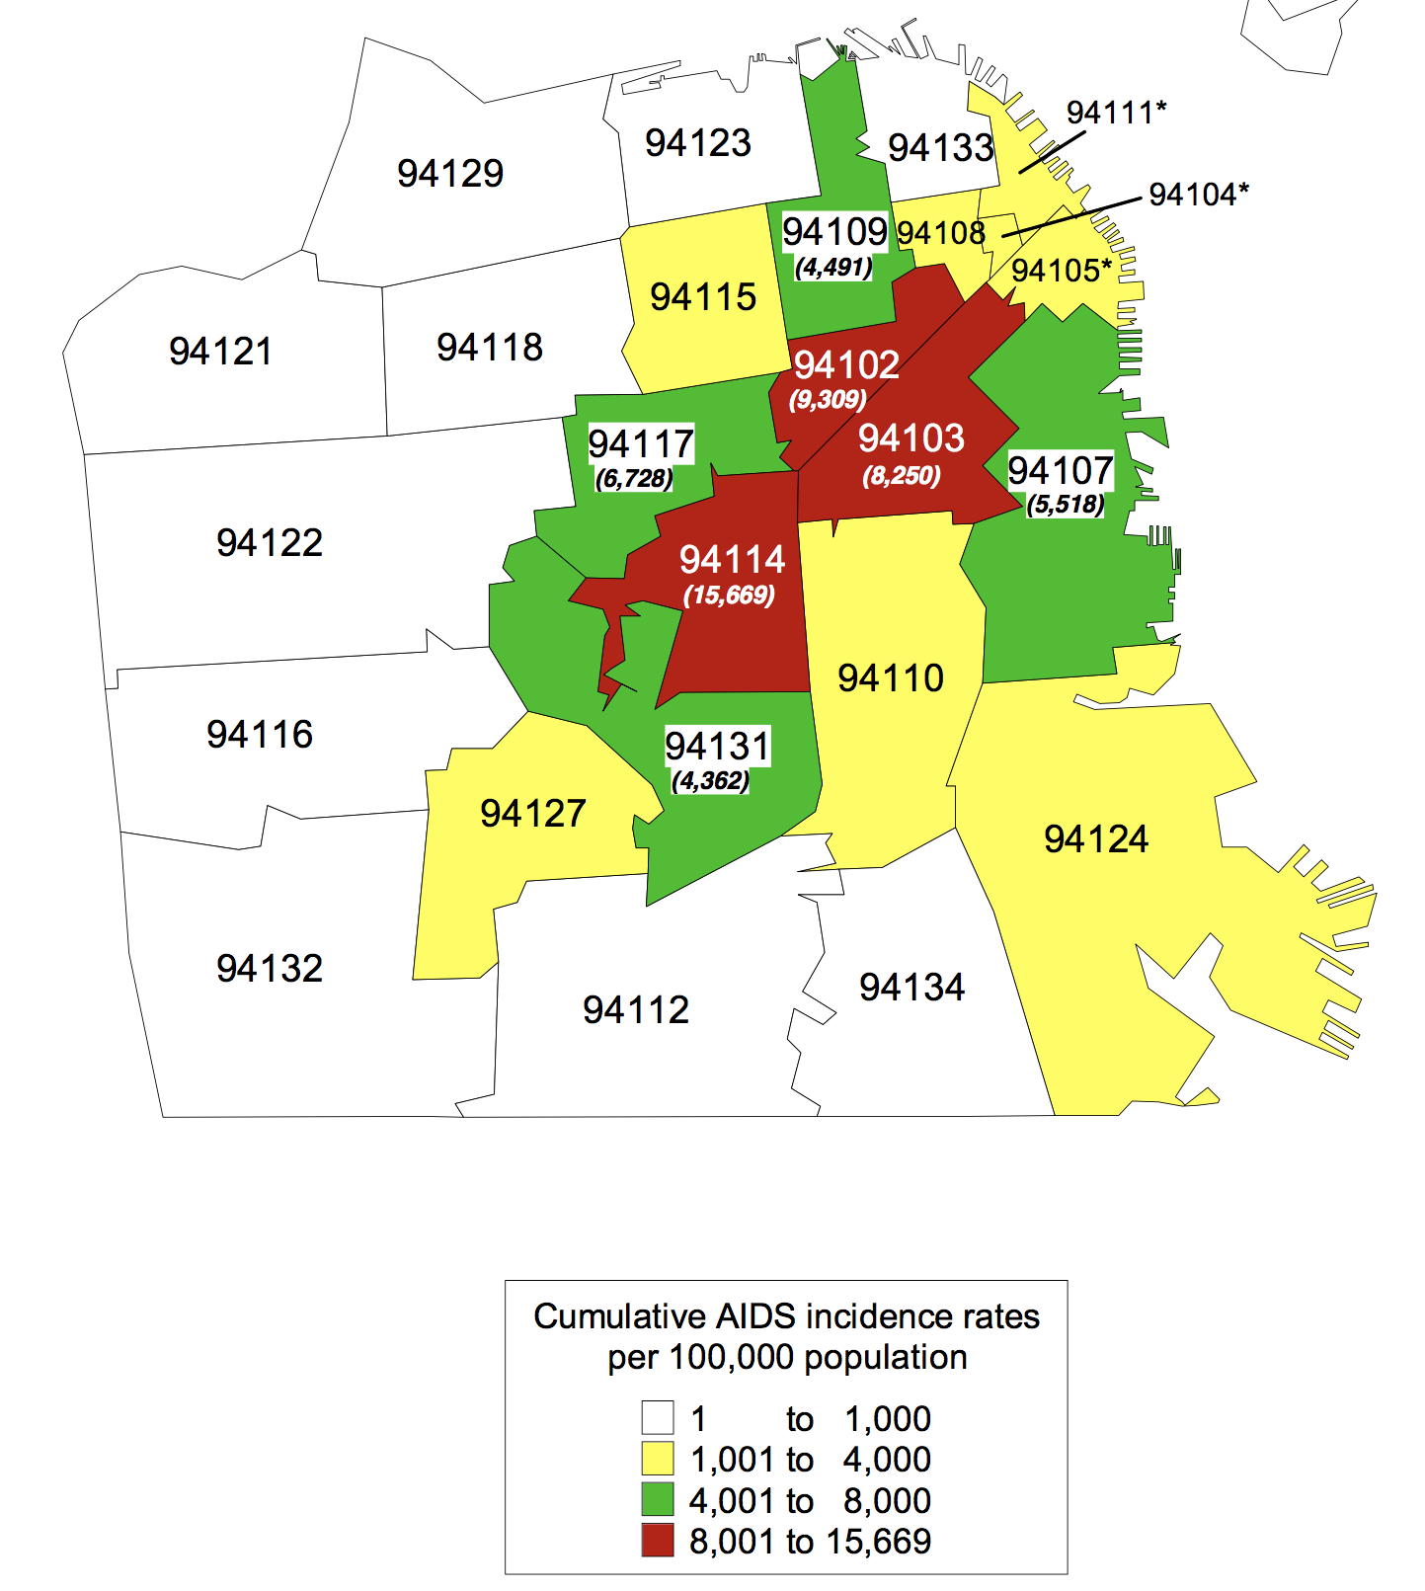
Comparison of the local geographies of AIDS activism (left) with Cumulative AIDS incidence rate (right, from 1980-1998)

Slide 17
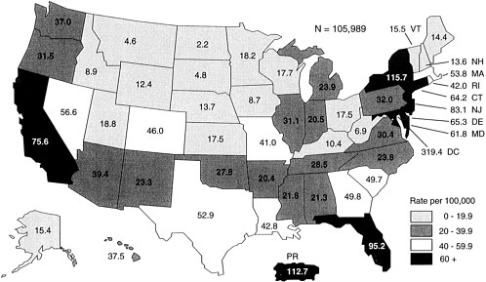
Comparison of the National geographies of AIDS activism (left) with AIDS incidence at the height of the crisis (right, from 1993)
Notes:
https://www.nap.edu/read/4975/chapter/5
Activism largely followed crisis zones.

Slide 18
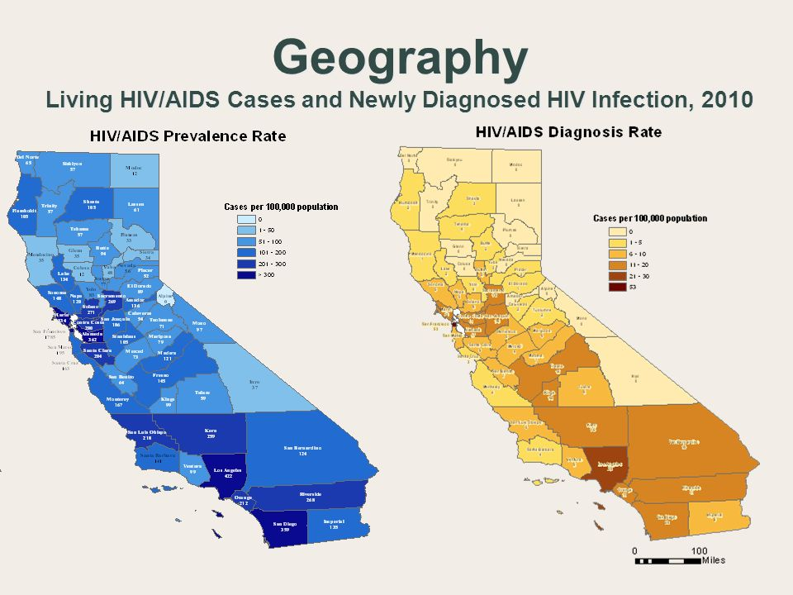
Historic Centers of Activism
In California
Notes:
While it certainly would need more investigation, it’s not a huge stretch to imagine that places with historic significance for AIDS activism are likely places that continue to be significant to the fight against HIV/AIDS.
It’s not outlandish to imagine that the strongest bases of activism are going to be those that are the oldest and most well established networks of activists
How do these historic centers of AIDS activism compare to the locations of new diagnosis today?
New diagnoses are happening more frequently in the central valley and inland empire, but those are areas with little to no history of activism.
REF: Epidemiology of HIV in California: Hot spots, cold spots, and program improvement Juliana Grant, MD MPH Chief, Surveillance, Research, and Evaluation Branch.
Juliana Grant, mD mph 2016 CDPH

Slide 19
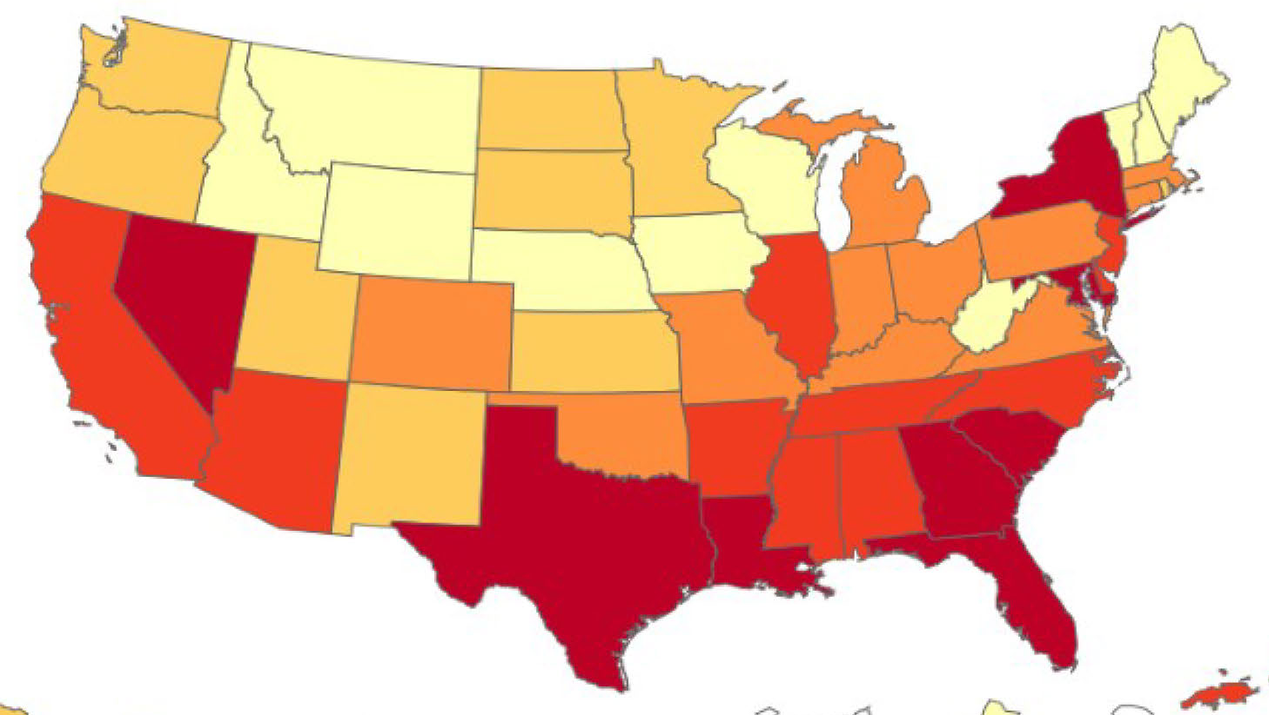
National historic centers of activism (left) vs annual HIV/AIDS incidence rate in 2016 (right)
Notes:
Some overlap definitely, but no representation at all for places like Nevada and South Carolina.
Overall, largely similar patterns.
REF: FIGURE 1.1 Annual incidence rates of AIDS for adults and adolescents per 100,000 population, for cases reported in 1993 in the United States. SOURCE: Valdiserri, 1994. (Black and white map)
Color Source (CDC)

Slide 20
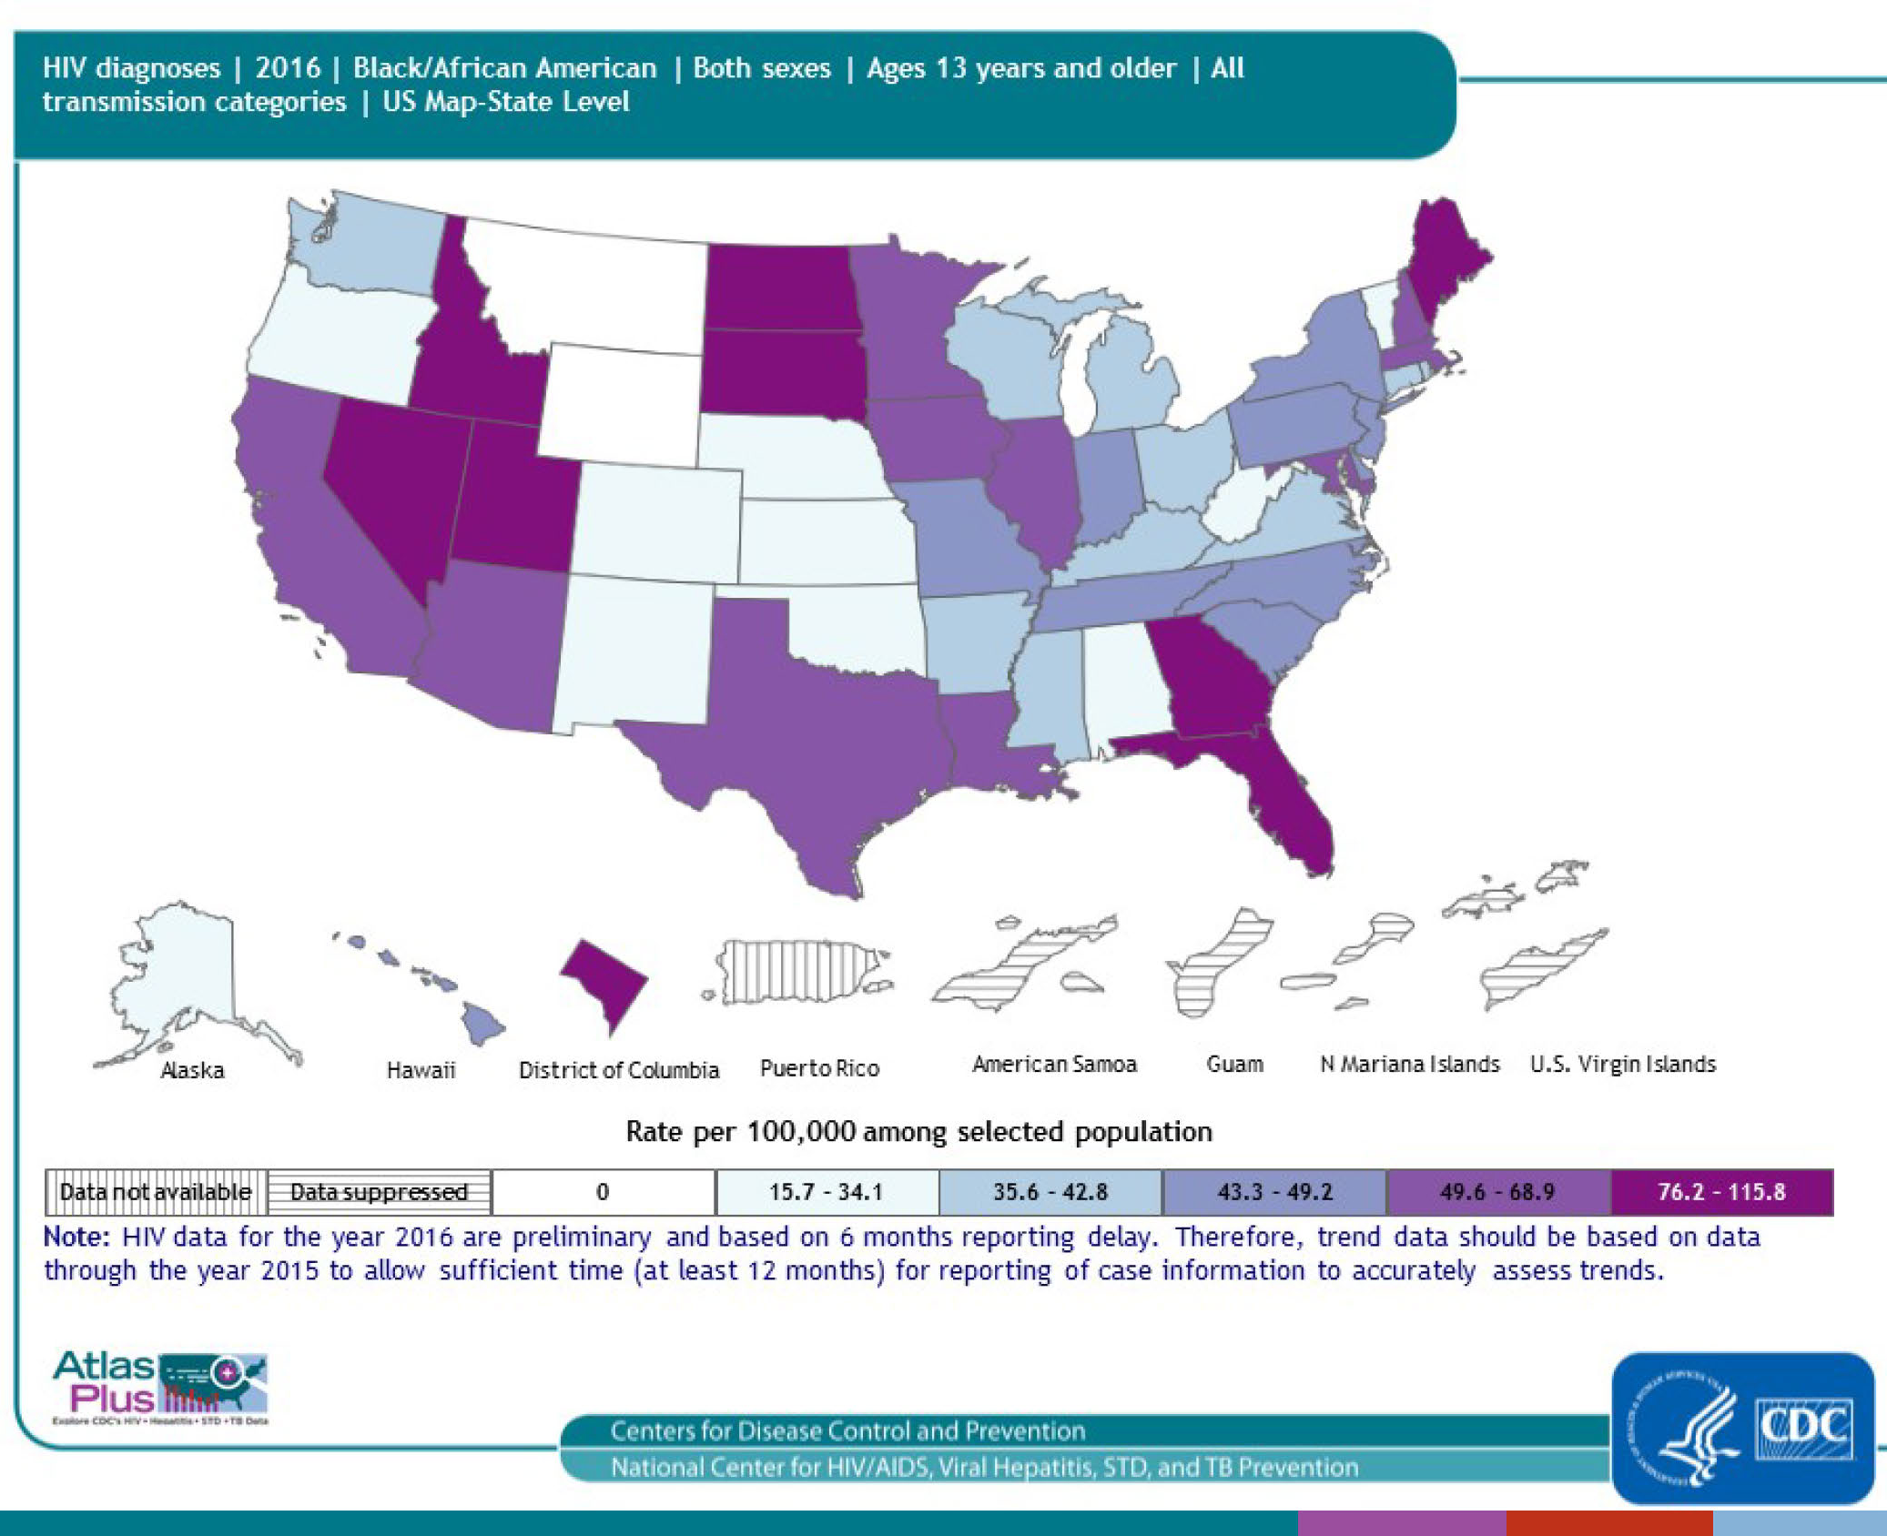
Historic Centers of Activism (left) vs HIV diagnoses amongst African Americans in 2016
Notes:
If we look at new HIV Diagnoses by Race, however, we see strongly different patterns:
Color Source (CDC)
We show in our map that historic activism centers are primarily clustered in coastal cities, which is a reasonable approximation for where the bulk of current cases of aids are happening.
If we look by race however, we see that certain populations might be missed by the established networks and that work may need to be done to focus activism and help on places like Idaho, North & South Dakota, Nevada, and Maine within the African American community

Slide 21
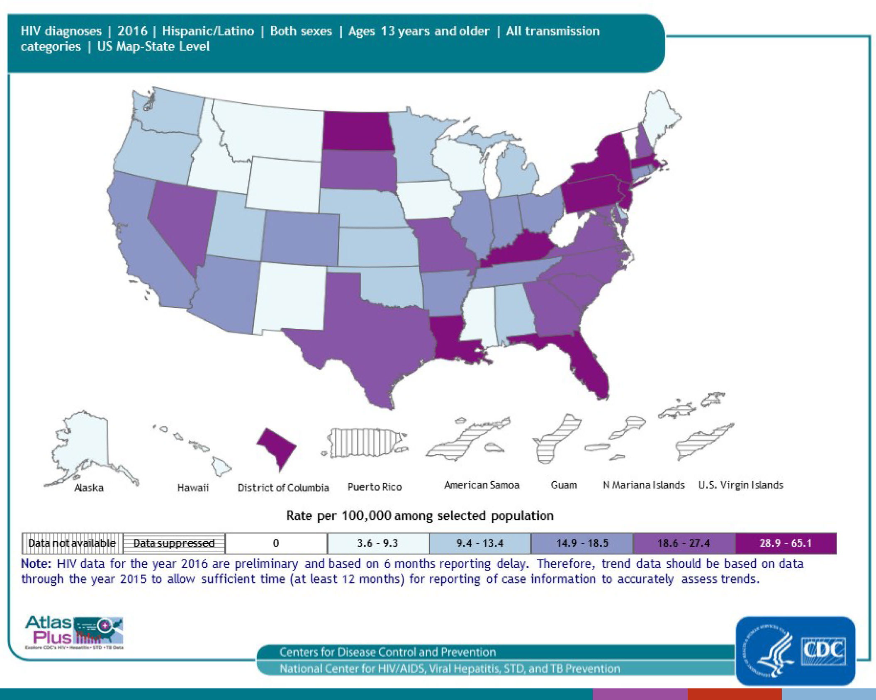
Historic Centers of Activism (left) vs HIV diagnoses amongst Latinos in 2016
Notes:
Color Source (CDC)
Similarly for the Hispanic population, we see that certain populations might be missed by the established networks and that work may need to be done to focus activism on places like Tennessee, Pennsylvania and Nevada.

Slide 22
Discussion
There are differences between centers of activism and centers of new HIV/AIDS diagnoses.
Establishing a local presence of activism is important for getting the resources necessary to fight the progression of the disease.
This is certainly preliminary work but it points to the need for further exploration of the interplay between centers of activism and centers of people from diverse populations living with a diagnosis of HIV/AIDS

Slide 23
Next Steps – where do we go from here?
Had originally hoped to include a measure of network connectivity between locations, as measured by number of co-occuring references to zip codes within single project. Not able to accomplish in time, but this has potential for future work
Other future ideas:
Geocoding actual address
record co-mentions within a certain (textual) distance
network graph/map
Co-occurring names in a similar fashion to identify key players/strong voices

Slide 24
Questions

Slide 25
Session Overview
Greetings & Quick Audience Survey
History: why did we start
Benefits: what benefits do we see at the community level
mindset/initial goals: what did we set out to do
growth: How have we grown and what did our growth look like
Current State: what it looks like now
Interactive Activity
Ideas for starting your own COPs

